Slide 1
Lecture-3 aquifer influx models
Pot aquifer
Schilthuis’ steady-state
Hurst’s modified steady-state
The van Everdingen-Hurst unsteady-state
Edge-water drive
Bottom-water drive
Linear-water drive
The Carter-Tracy unsteady-state
Fetkovich’s method
Radial aquifer
Linear aquifer

Slide 2
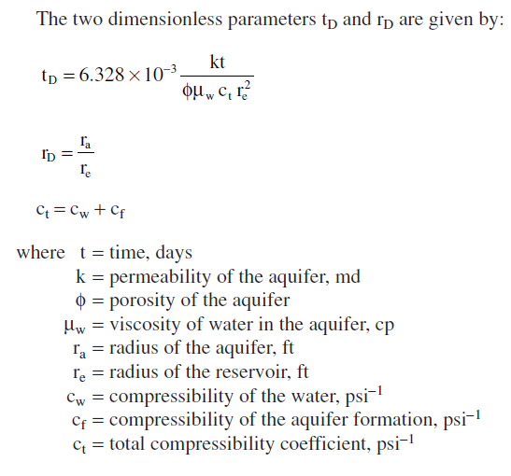
The van Everdingen-Hurst unsteady-state

Slide 3
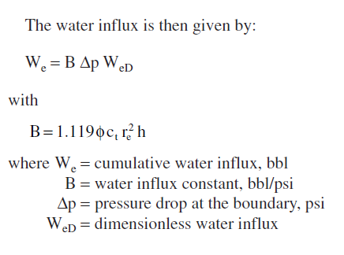
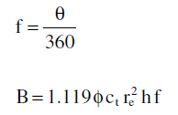
Water does not encroach on all sides of the reservoir, or the reservoir is not circular in nature.

Slide 4
Example- Van Everdingen and Hurst

Slide 5
Previous Solution
Δp=constant

Slide 6
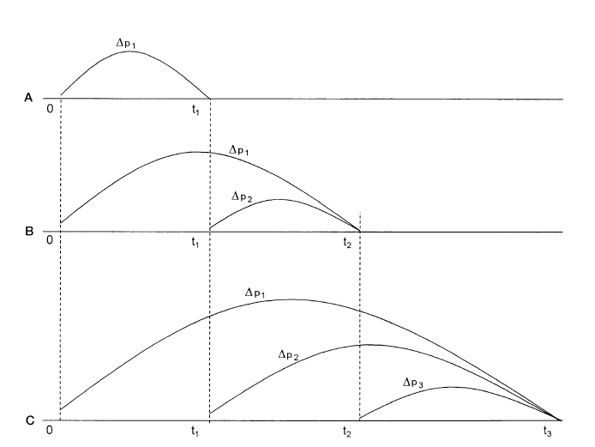
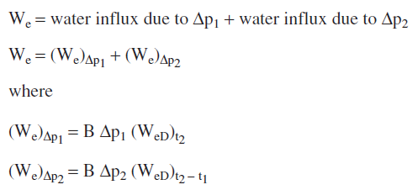
Multiple pressure drop
1st period
2nd period

Slide 7
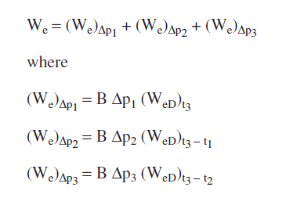
Multiple pressure drop
3rd period
In general

Slide 8
Calculation of Δp1,2,3,4,....
Δp1
Δp2
simplified
Δp3
Δp4

Slide 11
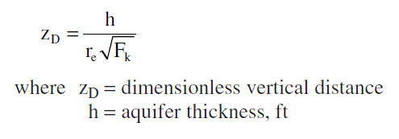
Bottom Water Drive

Slide 12
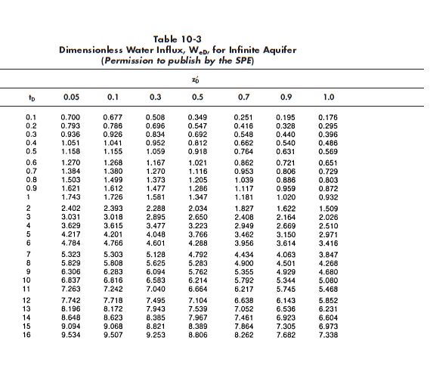

Slide 13
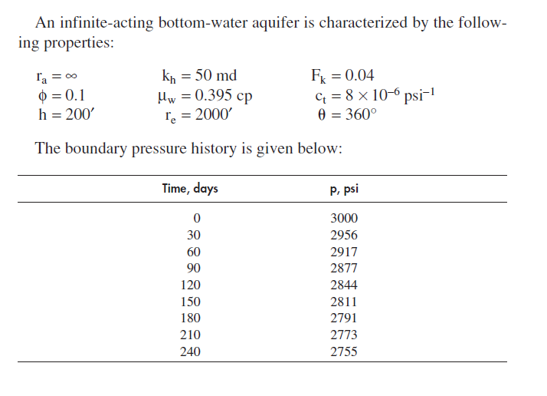
Example Bottom Drive

Slide 14
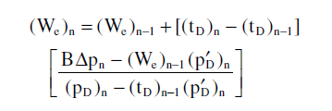
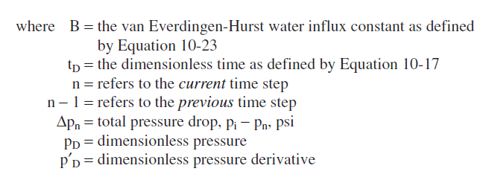
The Carter-Tracy Water Influx Model
The technique assumes constant water influx rates over each finite time interval.
The cumulative water influx at any time, tn can be calculatd directly from the previous obtained tn-1

Slide 16
Example 10-9 T.Ahmed

Slide 17
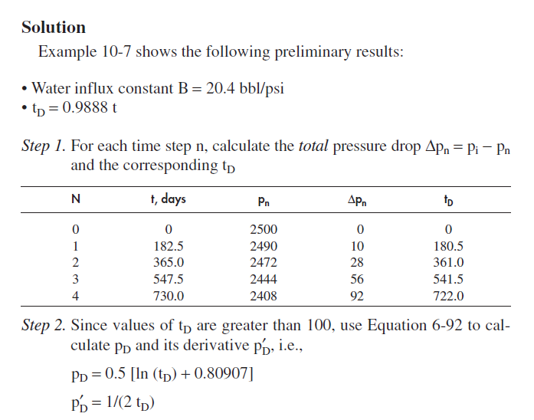
Solution

Slide 18
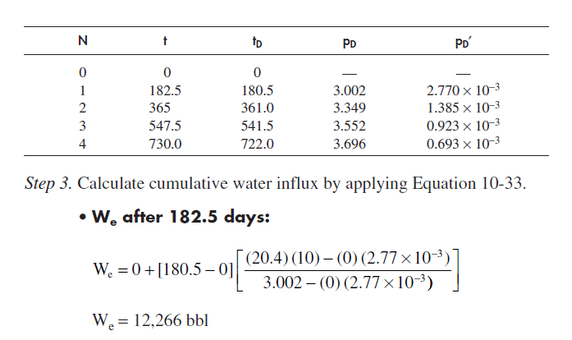
Solution

Slide 19
Carter Tracy method overestimates the water influx

Slide 21
See you next time inshallah
HAVE A NICE TIME

